Slide 1
FRONT END ENGINEERING-II
TRAVEL BLOG
Anjali Saini -2310990197
Anvesha Jagga – 2310990207
Arpita – 2310990213
Arshita Mahajan -2310990215
Class Group: G3 Project Group (PG) No.: PG7
Project Guide Name:
Mr. Sachin Garg

Slide 2
TABLE OF CONTENT
Introduction
Problem Statement
Technical Details
Key Features
Future Scope
Conclusion
Screenshots
References/Links used

Slide 3
INTRODUCTION
Travel is not just about the destination; it’s about the experiences that shape us. What memories have you created on your travels? Have you ever dreamed of wandering through vibrant markets, relaxing on sun-kissed beaches, or hiking majestic mountains? Join us as we uncover hidden gems and share unforgettable stories from around the globe. Let us inspire you to embark on your next adventure!

Slide 4
PROBLEM STATEMENT
Travel enthusiasts often struggle to find personalized recommendations, reliable information, and a sense of community while planning their trips. Our travel blog website aims to solve these issues by offering tailored travel recommendations based on user preferences, fostering community engagement through user-generated content and forums, and providing interactive features like quizzes and challenges. By delivering fresh, up-to-date content and personalized itineraries, we empower travelers to discover new destinations and connect with like-minded individuals, enhancing their overall travel experience.

Slide 5



TECHNICAL DETAILS
HTML (Hypertext Markup Language) is used to define the structure and content of a web page. It is a declarative language, meaning that it tells the browser what to display, but not how to display it.
CSS (Cascading Style Sheets) is used to style the content of a web page. It is a presentational language, meaning that it tells the browser how to display the content, such as the font, color, and layout.
BOOTSTRAP simplifies web development by providing these pre-built components and utilities, enabling developers to create functional and stylish websites more efficiently. It is widely used due to its ease of use, responsive design capabilities, and extensive documentation..

Slide 6
KEY FEATURES
Header: The header contains the website's logo, name, and a navigation bar. The logo and name establishes the identity, while the navigation bar allows users to quickly access different sections or you can say countries of the website.
Footer: The footer includes copyright information and links to social media profiles. This section provides essential legal information and additional ways for users to connect with us.
Form: A functional form is included for user input, which could be used for making inquiries. This form is a critical component for user interaction and data collection.
Custom Logos: Designed and implemented unique, visually appealing logos.
Interactive Design: Utilizes CSS hover effects for engaging user interactions.
Small Animations: Subtle animations enhance the user experience.
Modern Aesthetic: Clean and minimal design focused on user experience.

Slide 7
FUTURE SCOPE
Adding Animations :-
Use animations to make the website more lively and attractive. This can include smooth page transitions, animated buttons, and effects like fading or sliding elements as we scroll.
Adding More Countries :-
We’ll explore more and more countries and definitely add them in our website by which we can make sure to our viewers that to which they can enjoy more and more .
Online Post :-
In upcoming time we are aiming our website to make the users post their own reviews of their journey and help others to achieve a fascinating trip.

Slide 8
CONCLUSION
In conclusion, our travel blog website is designed to transform the way travelers plan and experience their journeys. By focusing on personalized recommendations, community engagement, and interactive features, we address the common challenges faced by travel enthusiasts today. We believe that every traveler deserves a unique and inspiring experience, and our platform will empower individuals to explore new destinations, share their stories, and connect with fellow adventurers. Together, we can foster a vibrant community of explorers ready to embark on their next adventure with confidence and excitement. Thank you for considering our vision for a more engaging and personalized travel experience!

Slide 9
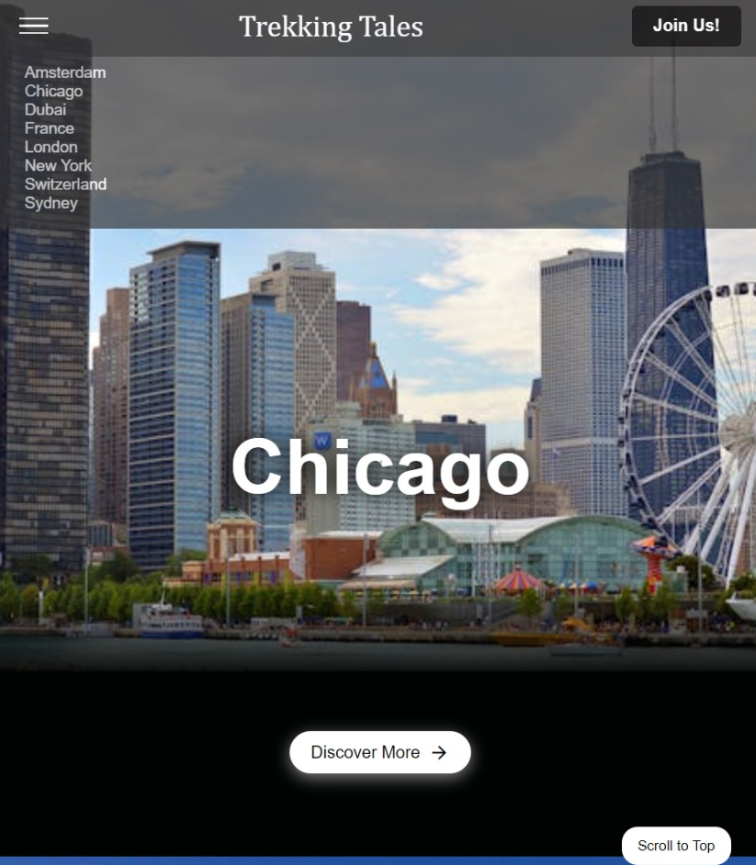
SCREENSHOTS

Slide 10
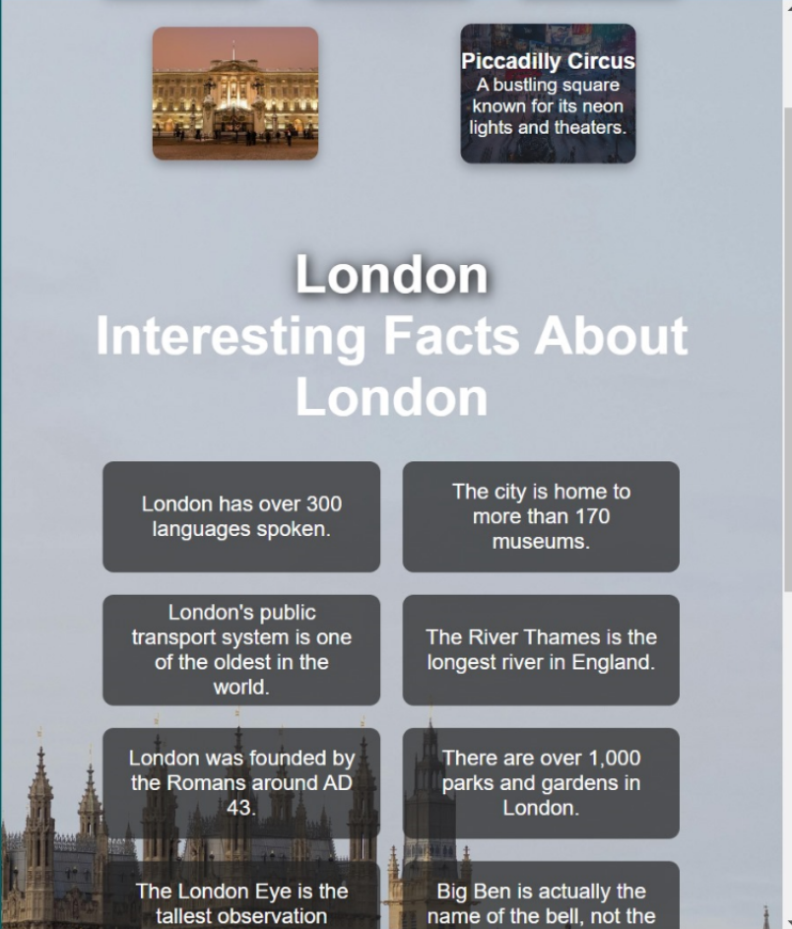

Slide 11
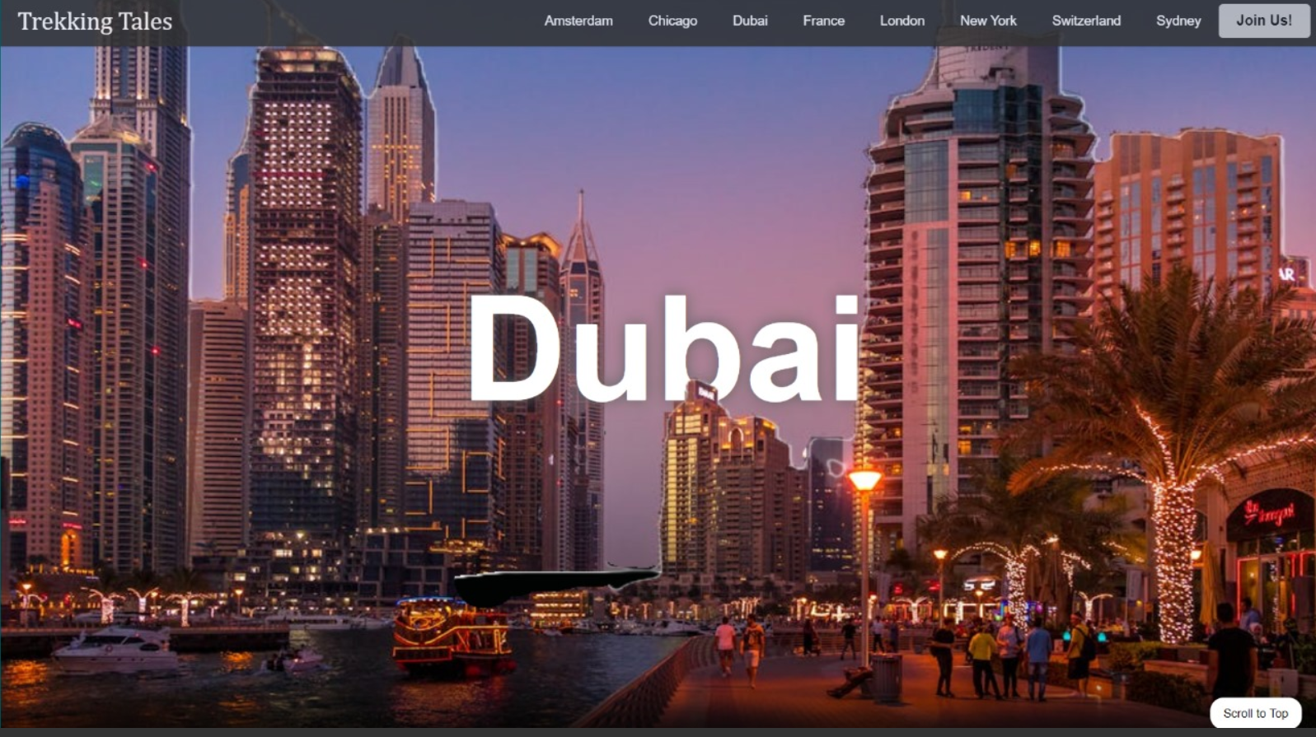

Slide 12
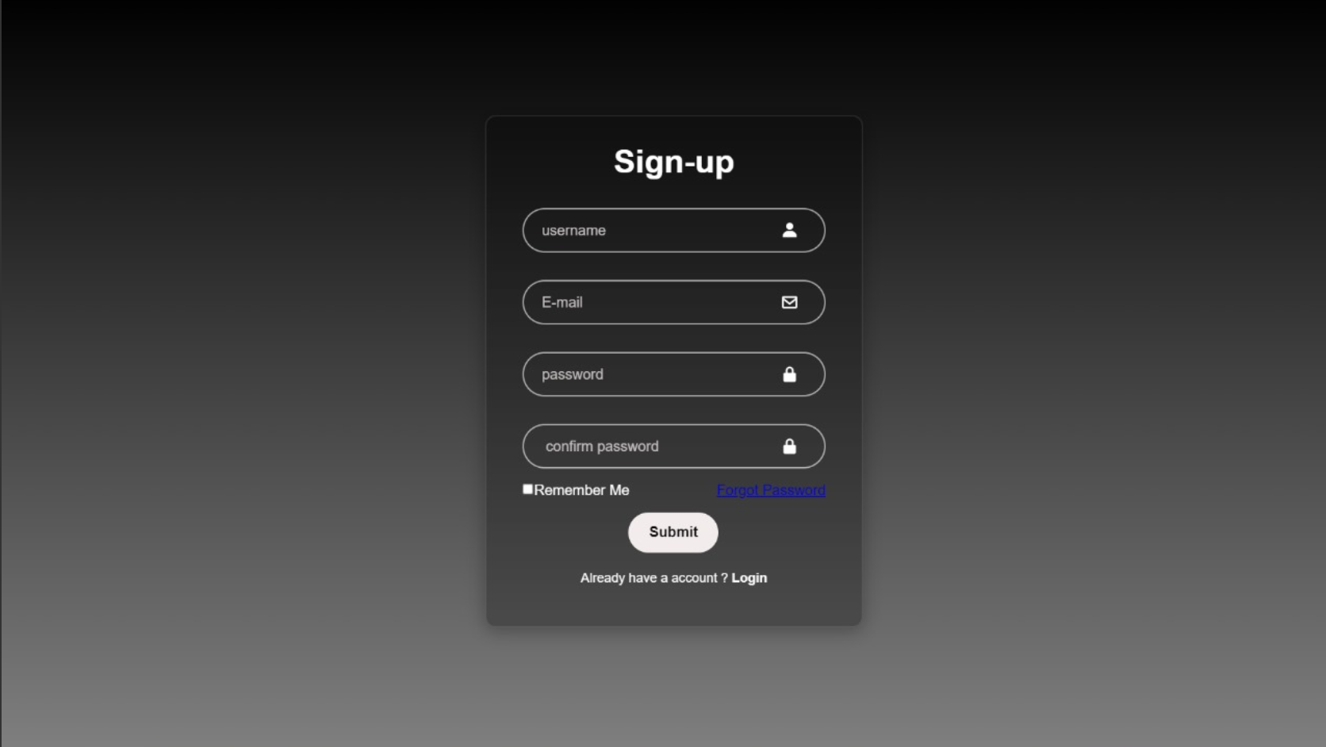
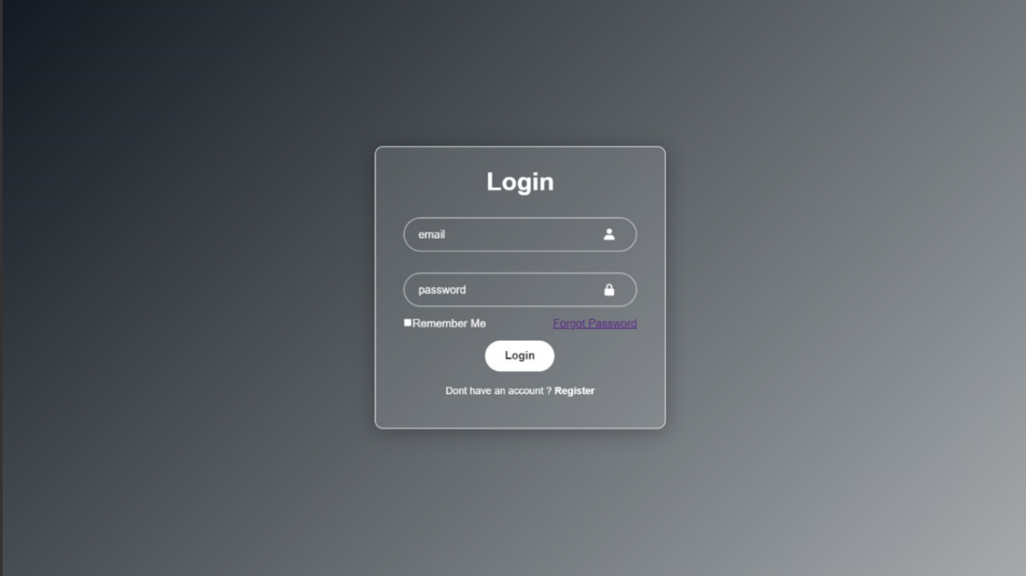

Slide 13
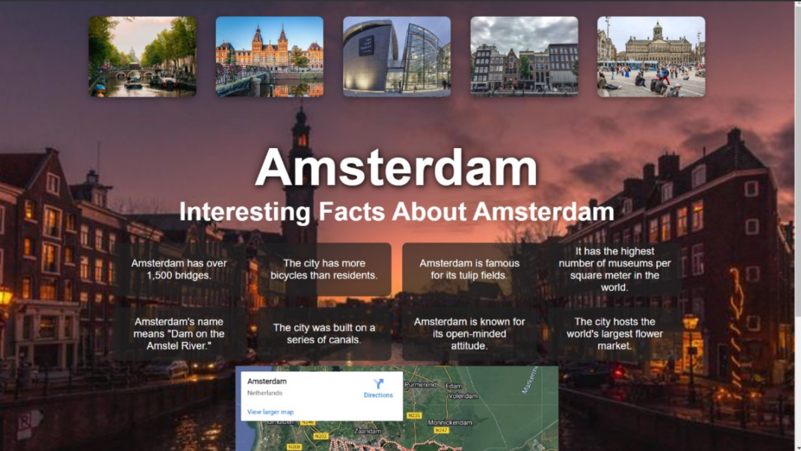

Slide 14
REFERENCE LINKS
In class guidance from our Teacher’s lectures and tutorials
W3SCHOOLS

Slide 15


